Slide 1
Mathematical Foundation of Machine Learning
III Deep Neural Networks and Dynamical Systems

Slide 2
Outline
CNN and its tricks, papers (Chapter 9)
RNN and LSTM, attention mechanism (Chapter 10)
Neural Networks and ODE/PDE/SDE

Slide 3

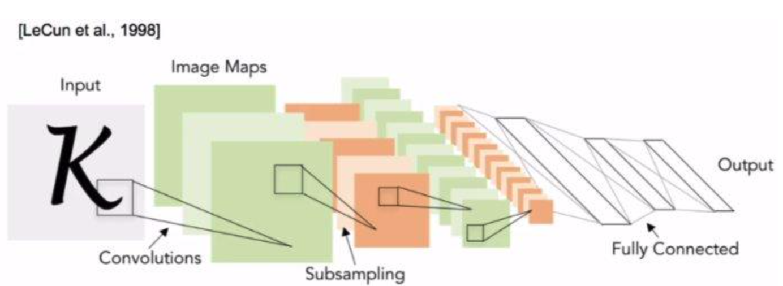
Convolution NN
MNIST dataset: each grayscale image is a 28 * 28 matrix.
Features automatically learned by NN: Filtering, Padding, Pooling.

Slide 4
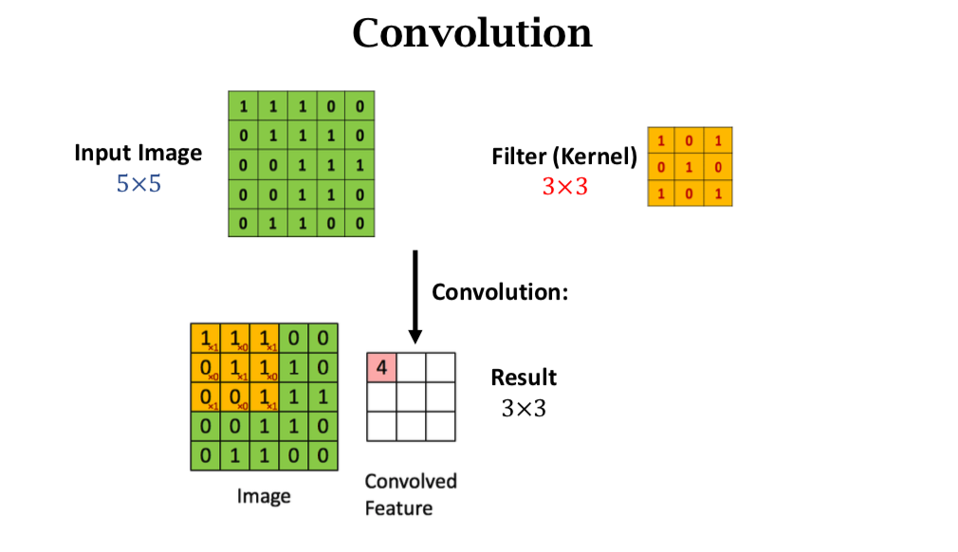

Slide 5
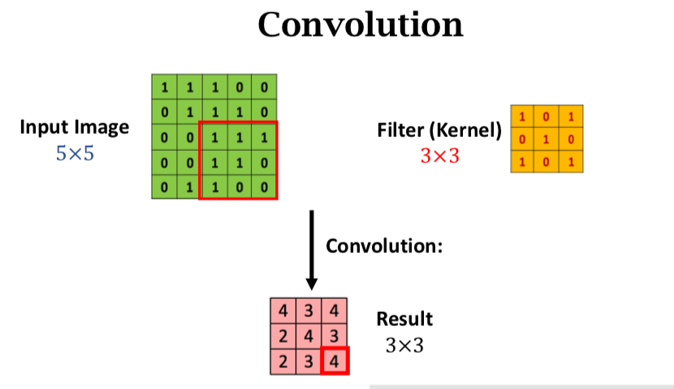

Slide 6
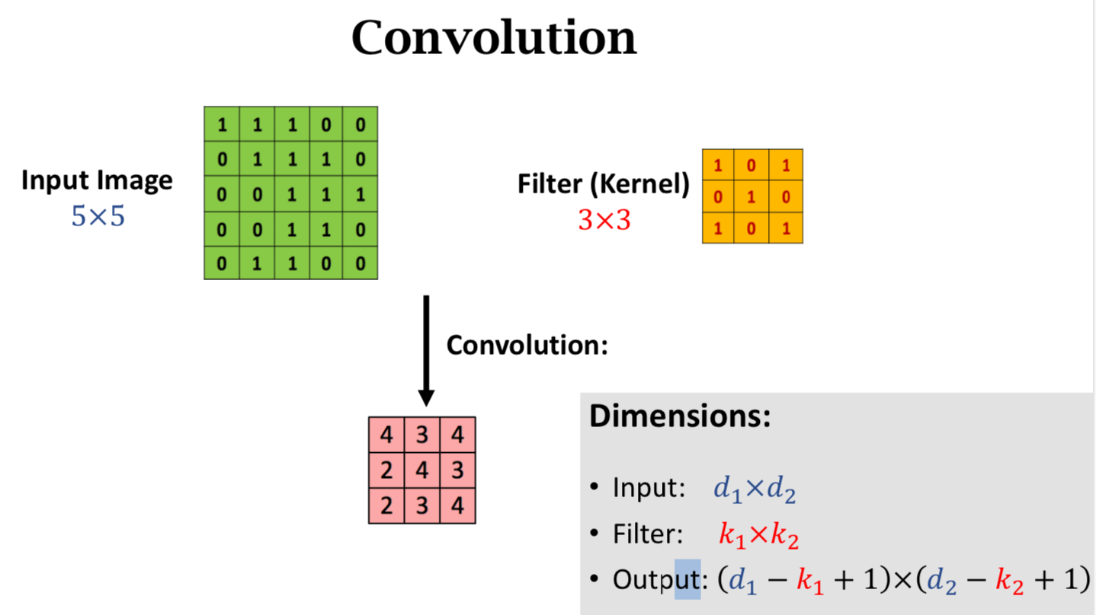

Slide 7
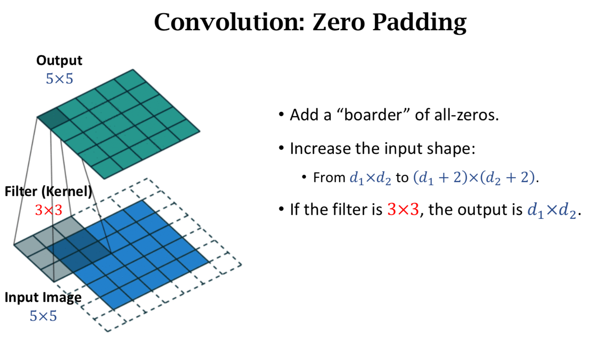

Slide 8
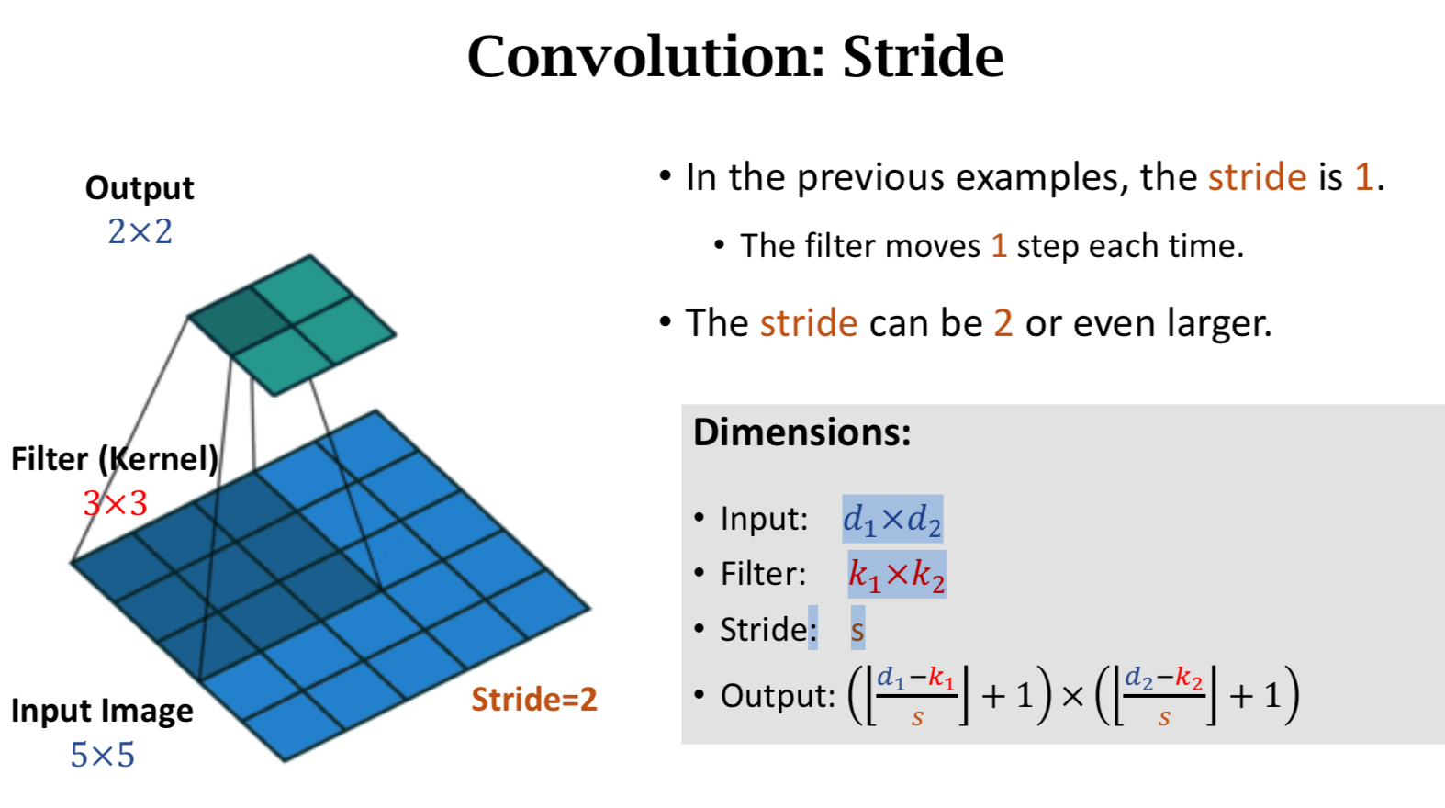

Slide 9
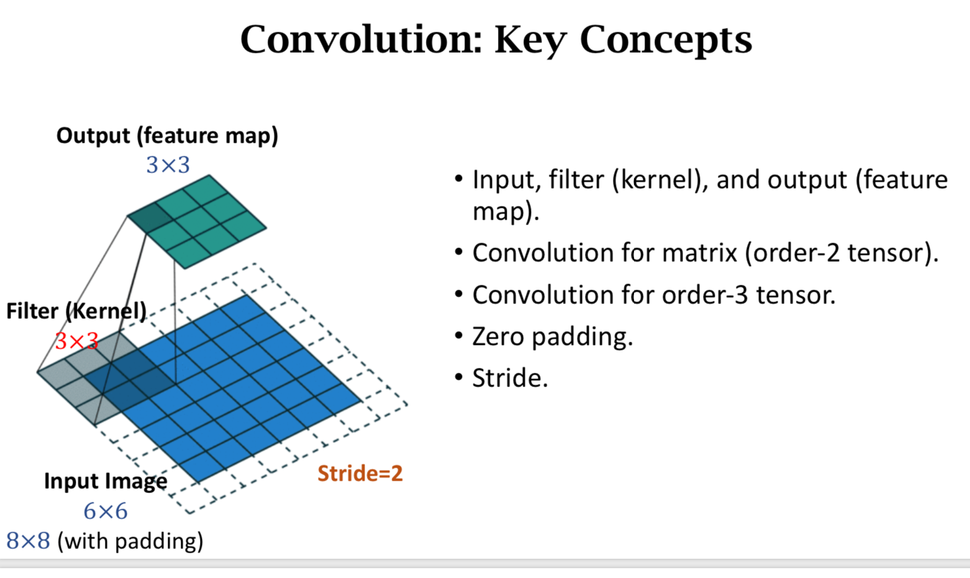

Slide 10
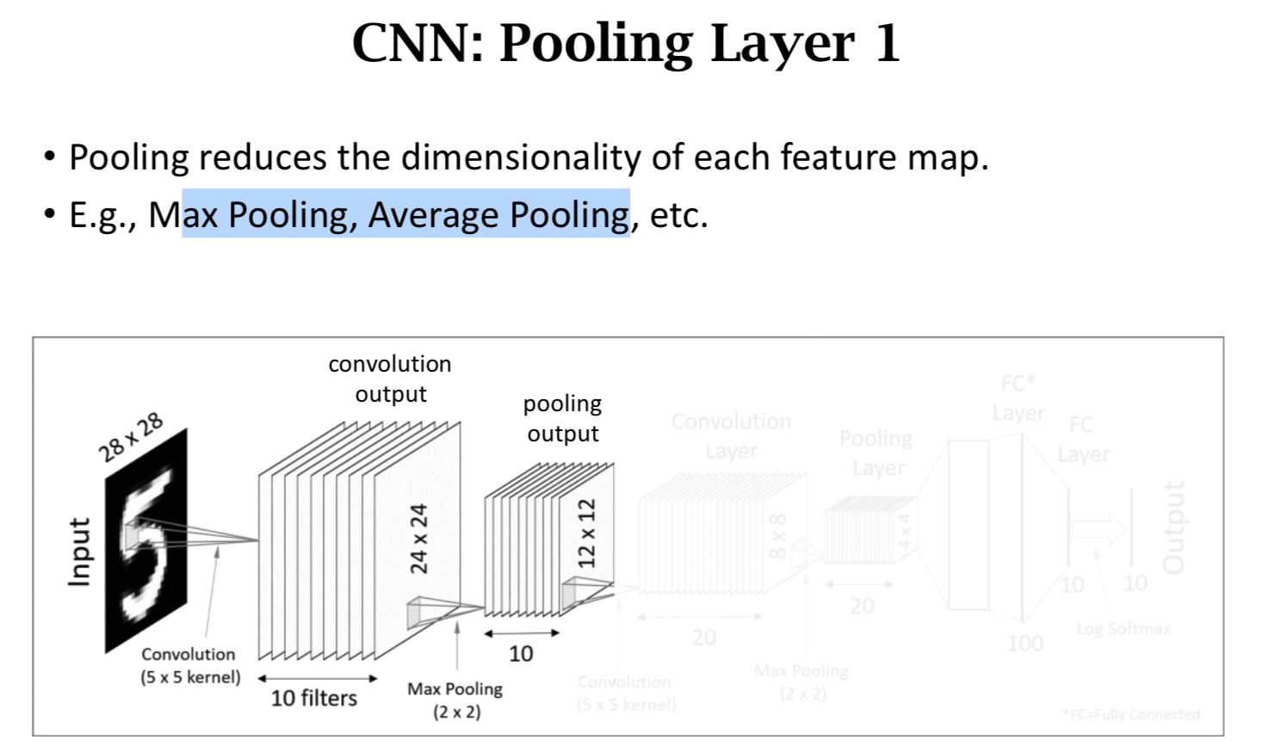

Slide 11
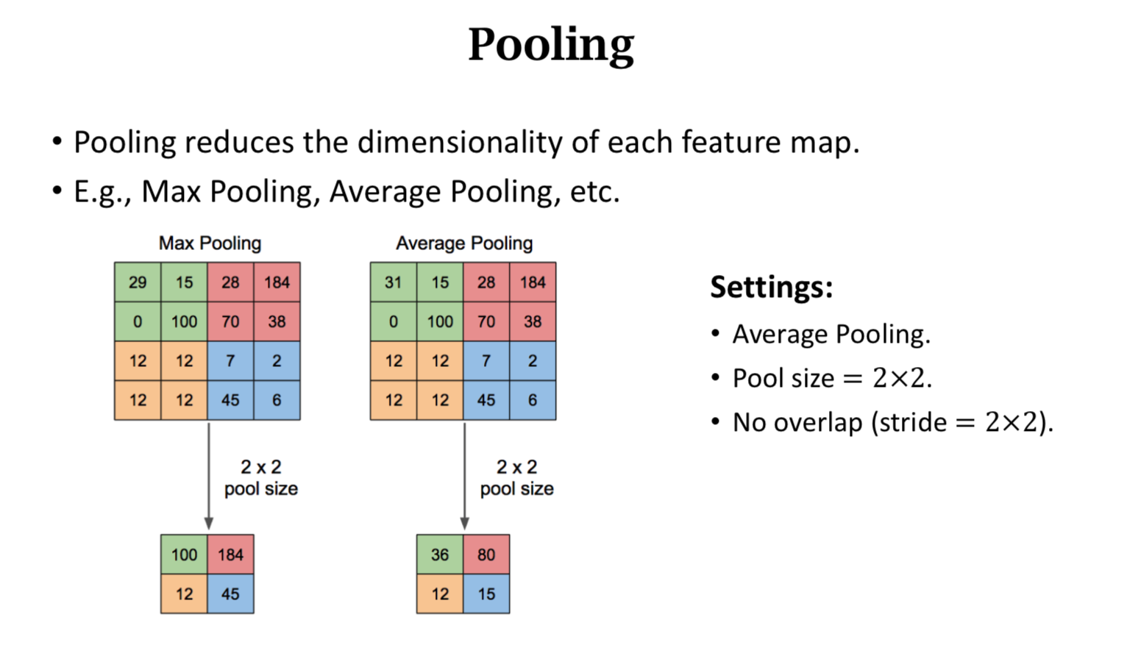

Slide 12
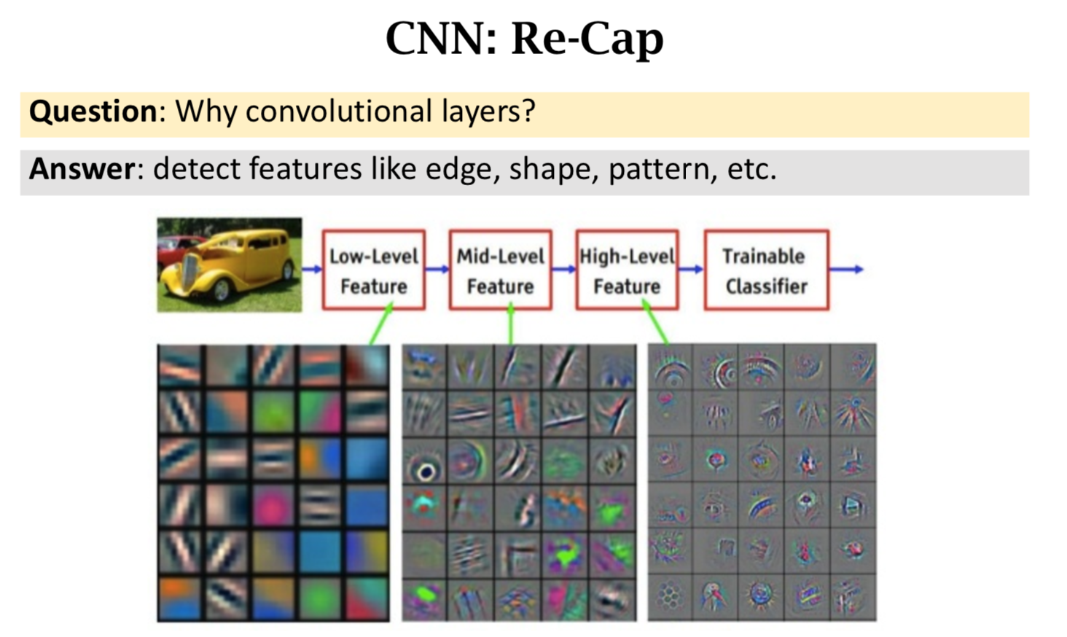

Slide 13
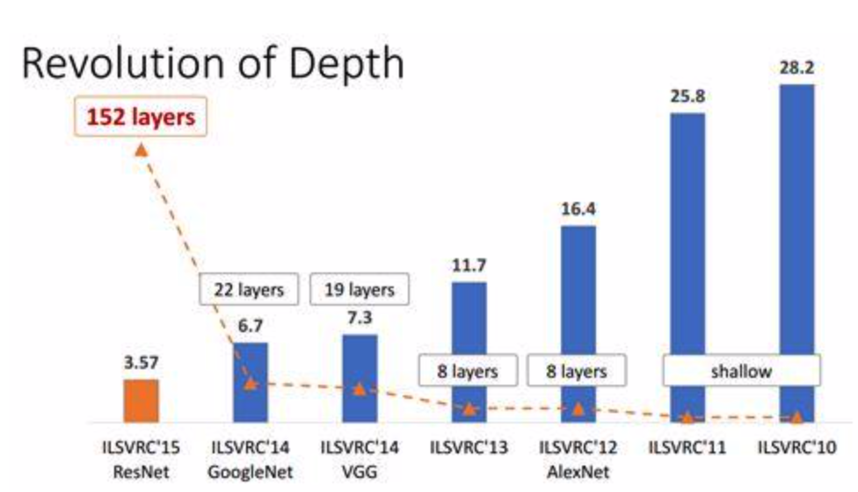
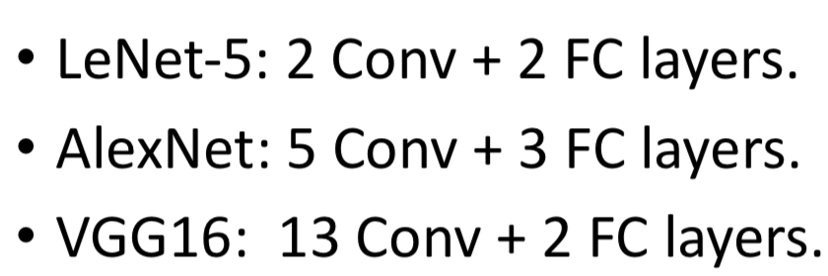
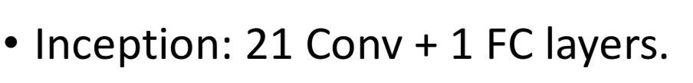
How deep can we do?
Why VGG19 has problem? Gradient Vanishing!
A: Bad optimization, cannot find good local minimum
Inject additional gradient at lower layers.

Slide 14
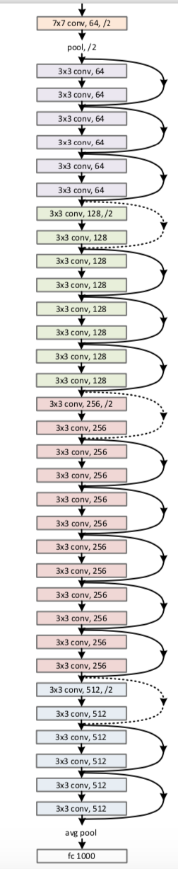
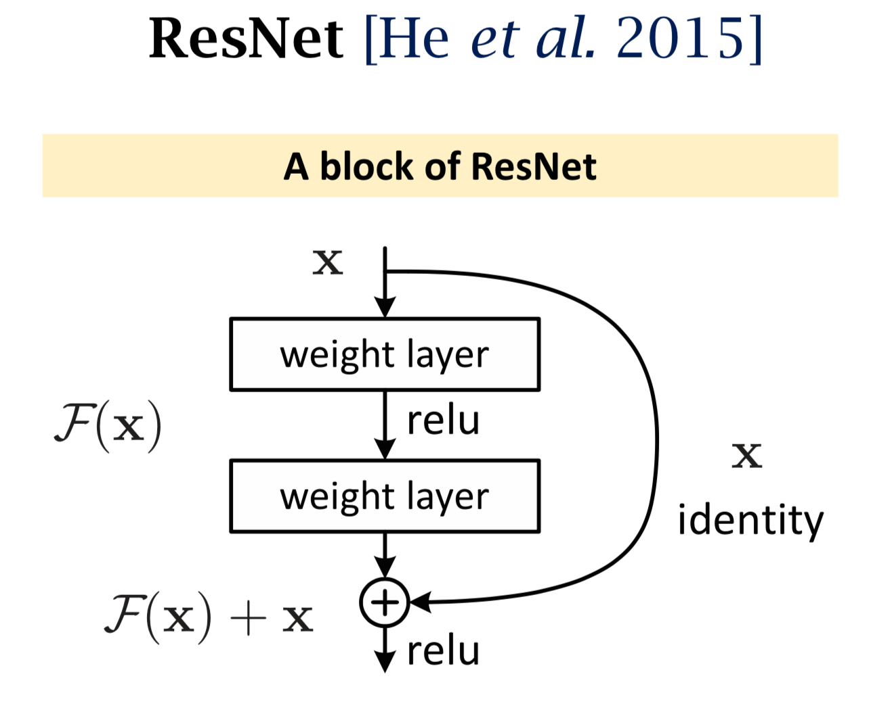

Slide 15
Some Tricks

Slide 16
Dropout
In each iteration of training (1 forward + 1 backward), randomly mask 50% (or an arbitrary percentage) of the neurons.
Why works?
make decision based on part of the features:
Like the L1 and L2 norm regularizations; Alleviate overfitting.
Wager, Wang, & Liang. Dropout Training as Adaptive Regularization. In NIPS, 2013.

Slide 17
Data Augmentation
• Data augmentation: generating more training samples from existing training data. e.g. flip, rotation, crop, shift, add random noise.

Slide 18
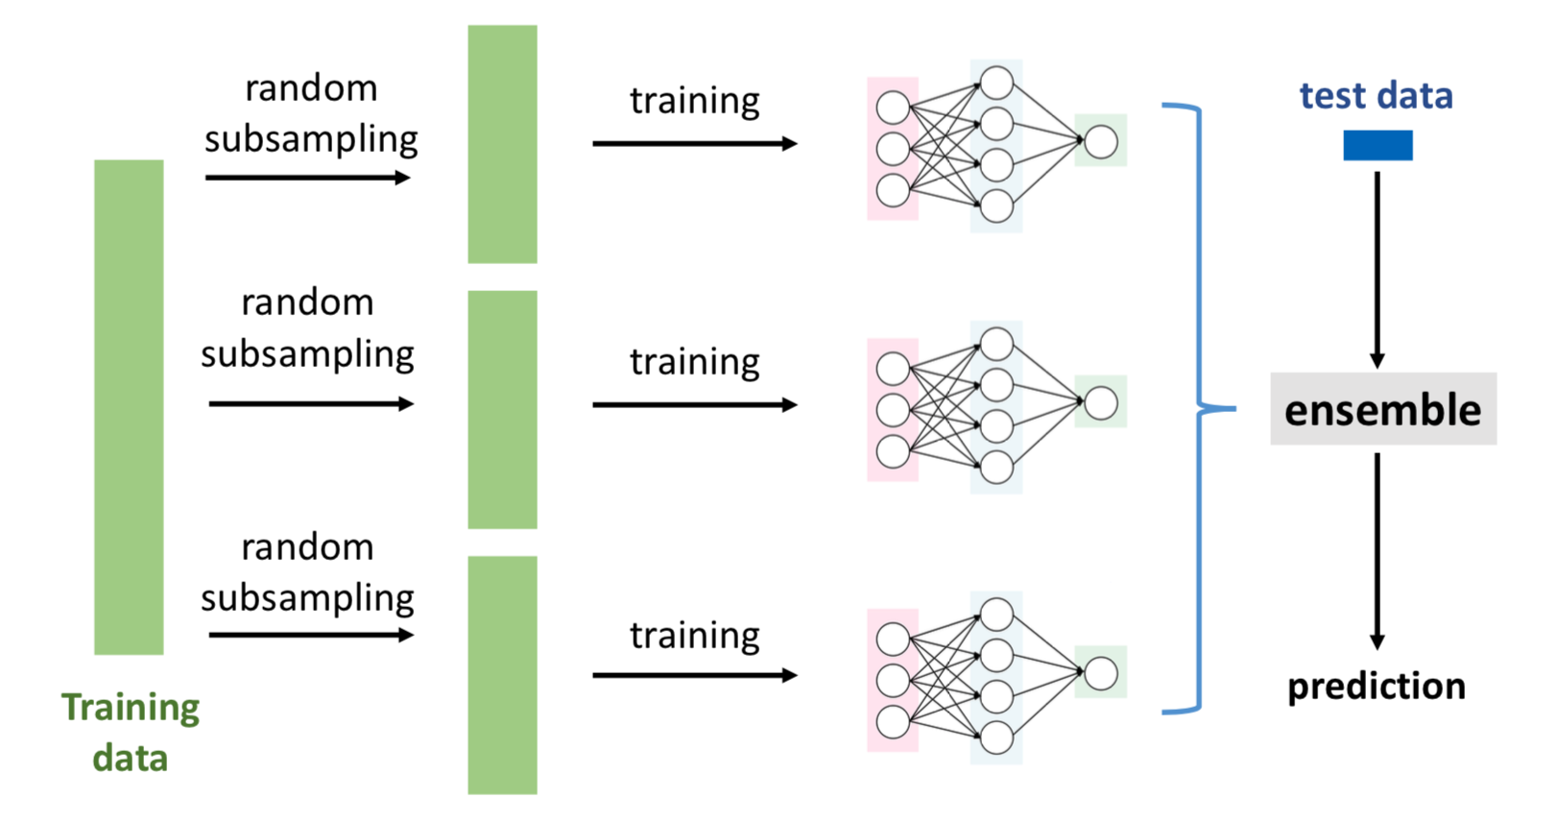
Ensemble methods
Varying models.
Different network structures.
Different random initializations.
Different optimization algorithms.
Varying data.

Slide 19
Ensemble methods
Varying models.
Different network structures.
Different random initializations.
Different optimization algorithms.
Varying data.
Ensemble method reduces variance.

Slide 20
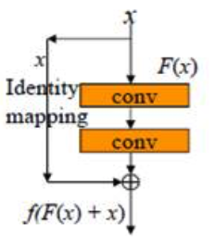
Tricks summary
For better generalization
dropout, data augmentation, ensemble methods, pretrain, multi-task.
For better optimization
Batch normalization, Gradient injection(Google Inception Net),
skip connection(ResNet)

Slide 21
Why Resnet works？(research papers)
Ensemble point of view
FractalNet, resNetwithStochasticDepth, wideResNet, Pyramid ResNet,multi-residual blocks......
numerical ODE/PDE

Slide 22
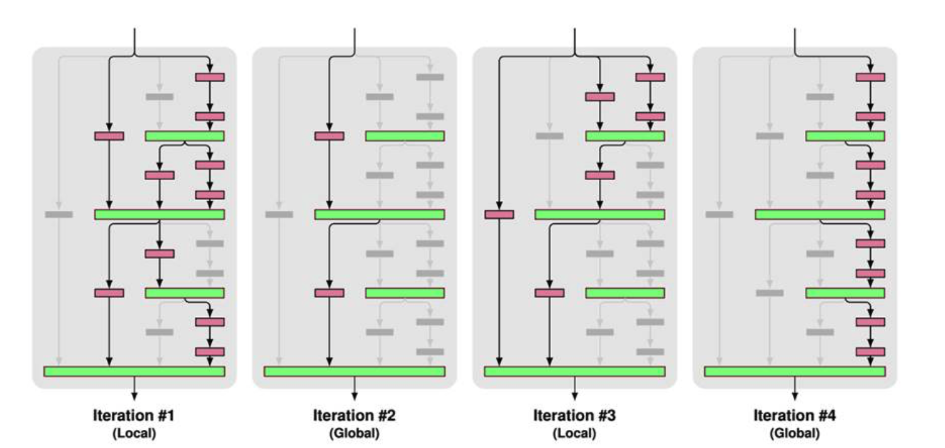
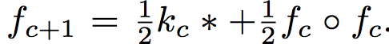
Fractal Net: dropout path (force independence of shallow nets.)
Fractal Net can be written as

Slide 23
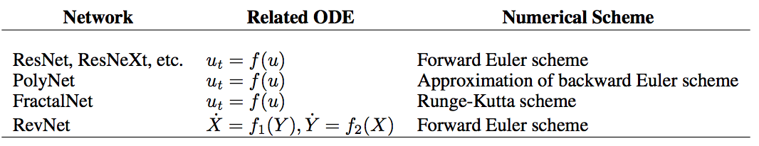
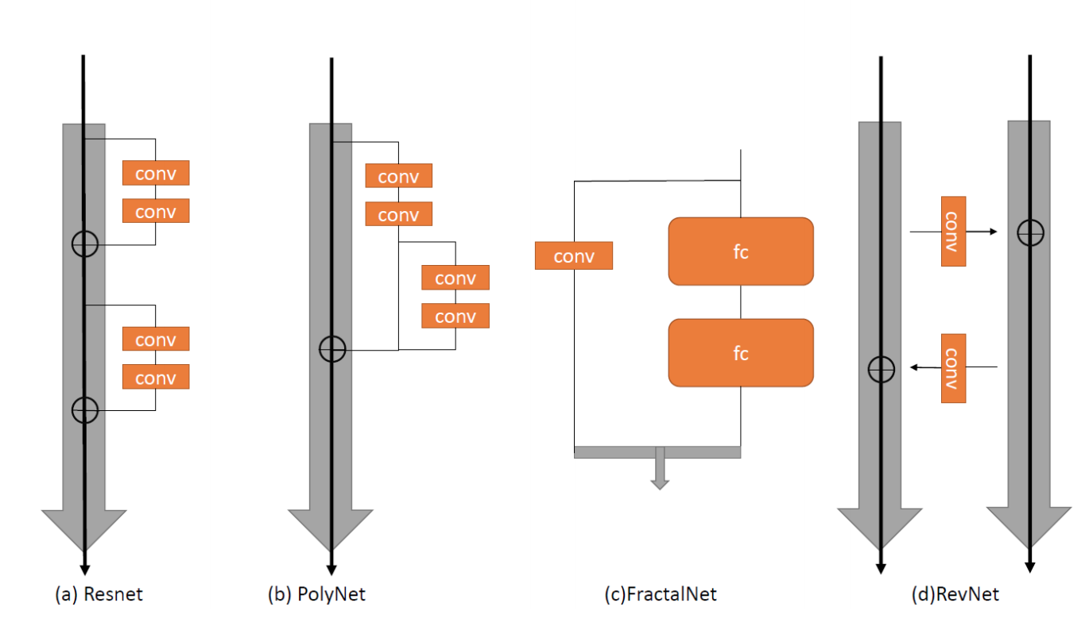
BEYOND FINITE LAYER NEURAL NETWORKS: BRIDGING DEEP ARCHITECTURES AND NUMERICAL DIFFERENTIAL EQUATIONS

Slide 24
Outline
CNN and its tricks, papers (Chapter 9)
RNN and LSTM, attention mechanism (Chapter 10)
Neural Networks and ODE/PDE/SDE

Slide 25
RNN: sequential data modeling
NLP: sentiment analysis, abstract generation....
Language Translation
Stock/portforlio prediction
Weather forecasting
........
many to one or Many to many problem: no need to fix length of input or output

Slide 26
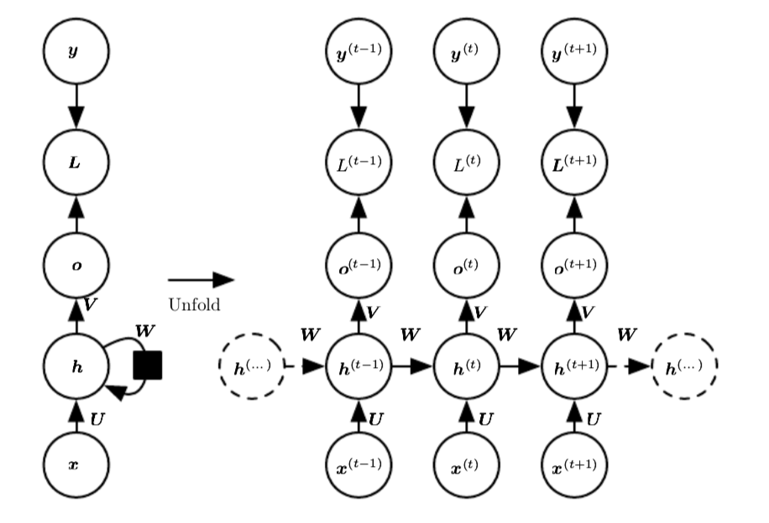
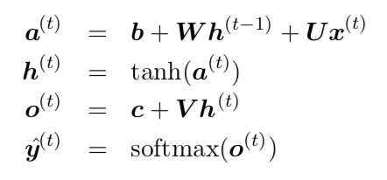
RNN
BPTT: back propagation through time

Slide 27
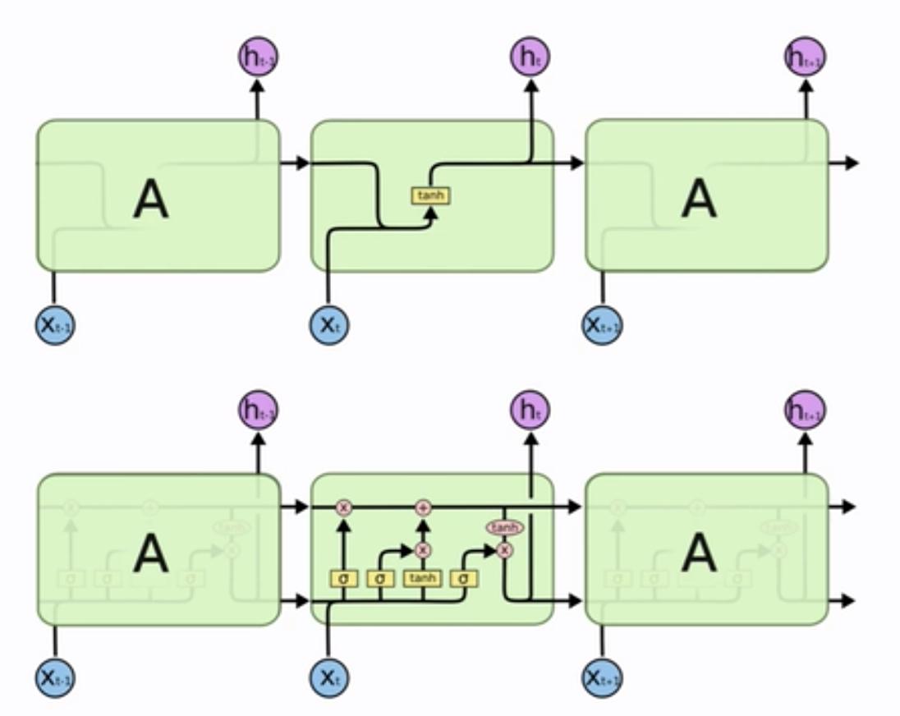
LSTM

Slide 28
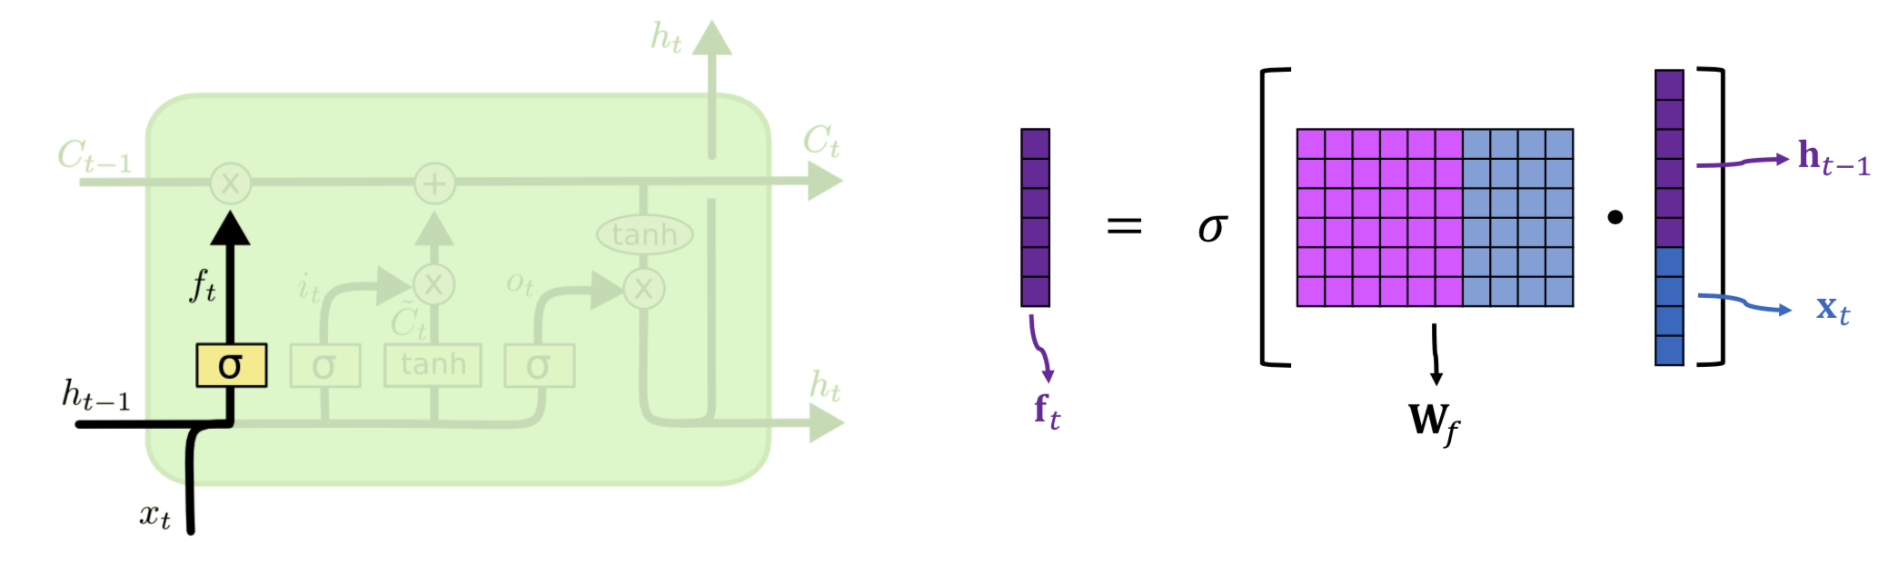
Forget Gate

Slide 29
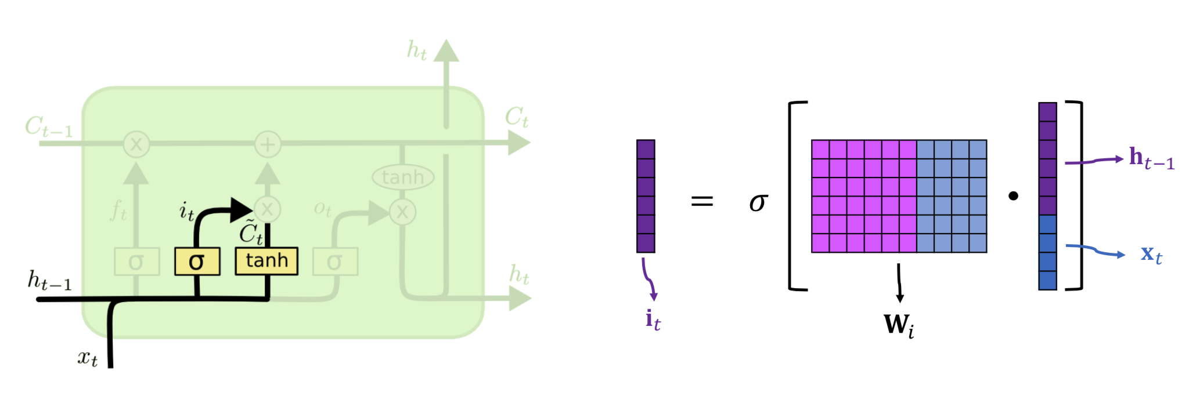
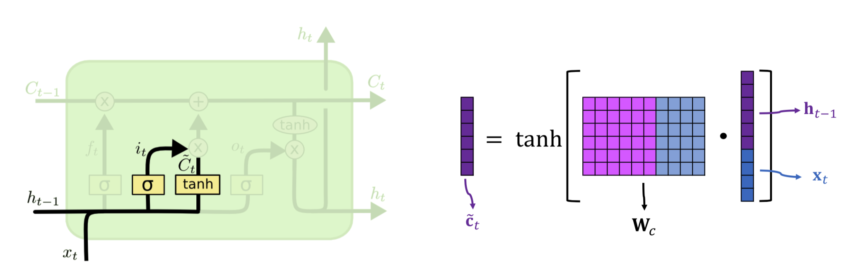
Input Gate and New Value

Slide 30
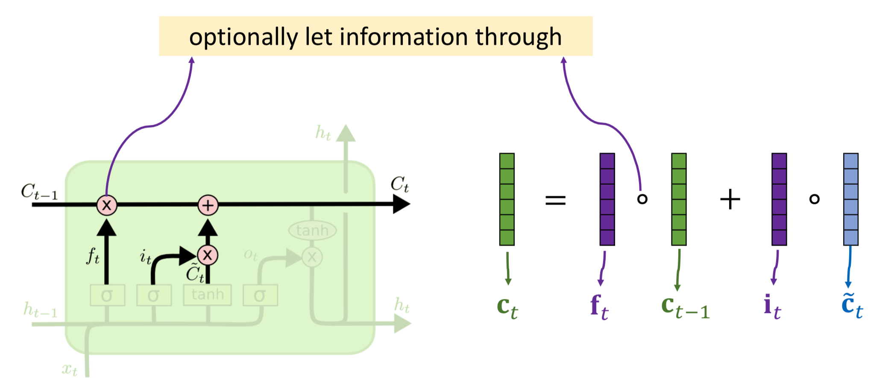
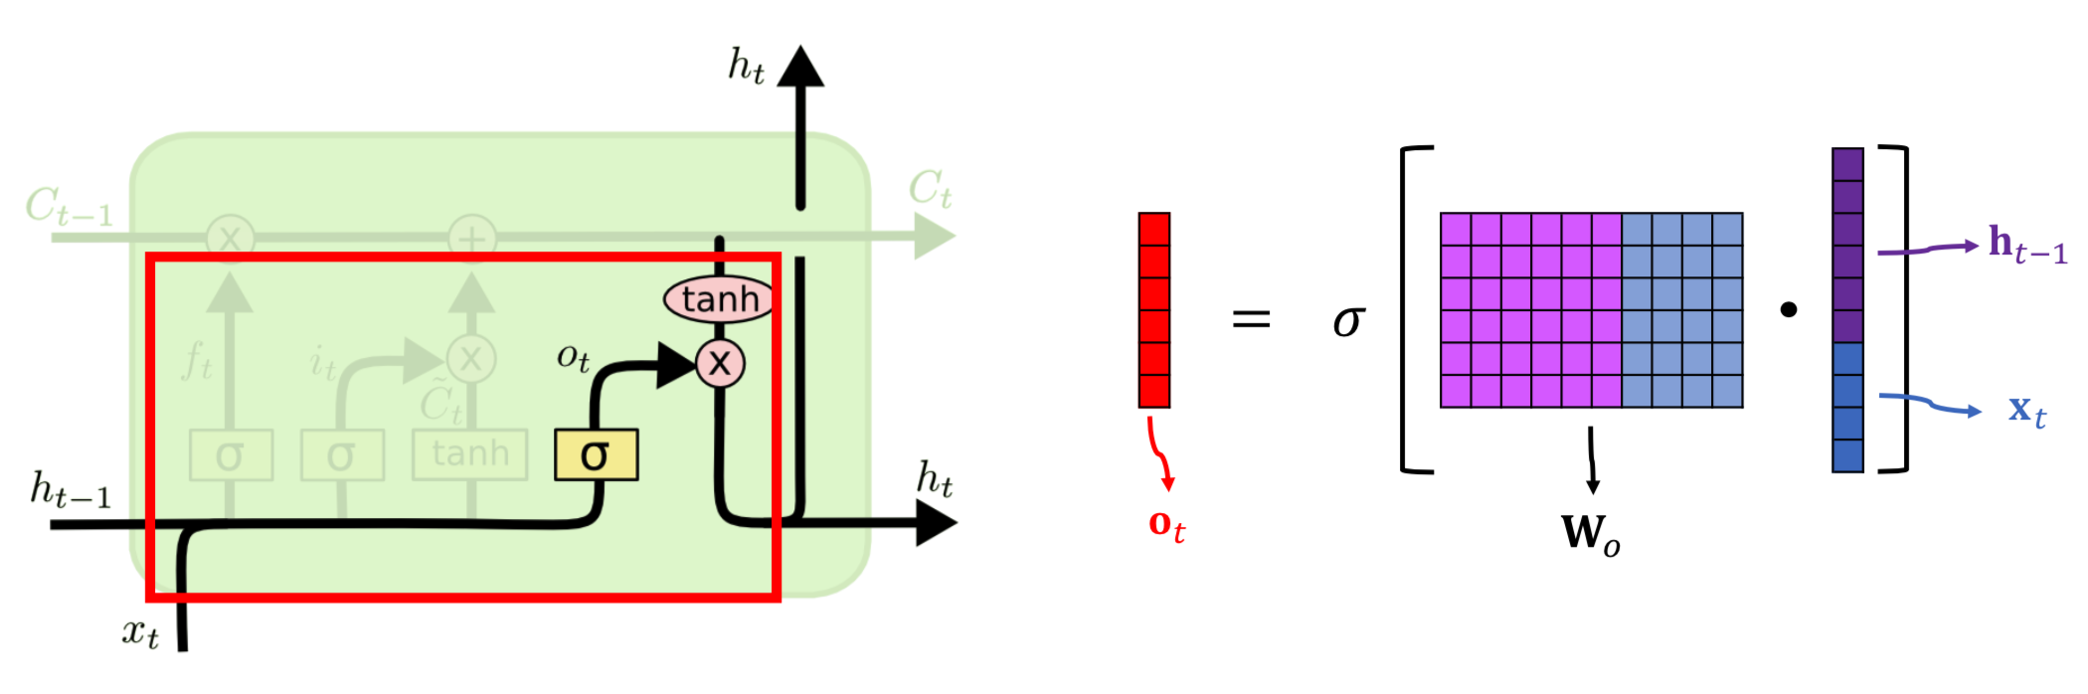
optional let info through and update conveyor belt

Slide 31
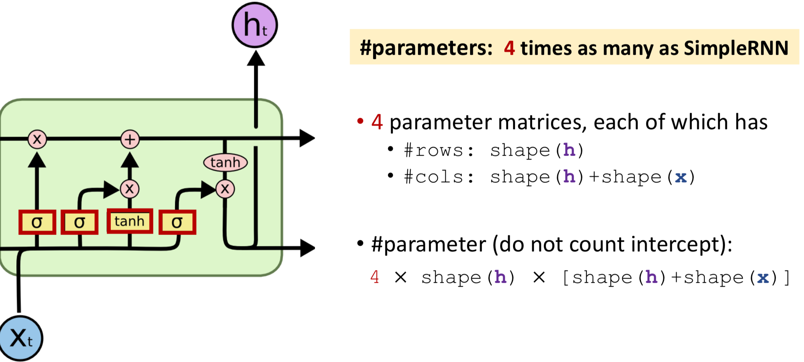
Output Gate

Slide 32
Multimodal Learning
CNN LSTM (image caption )
LSTM LSTM
( translater, abstract generation, chatbot)

Slide 33
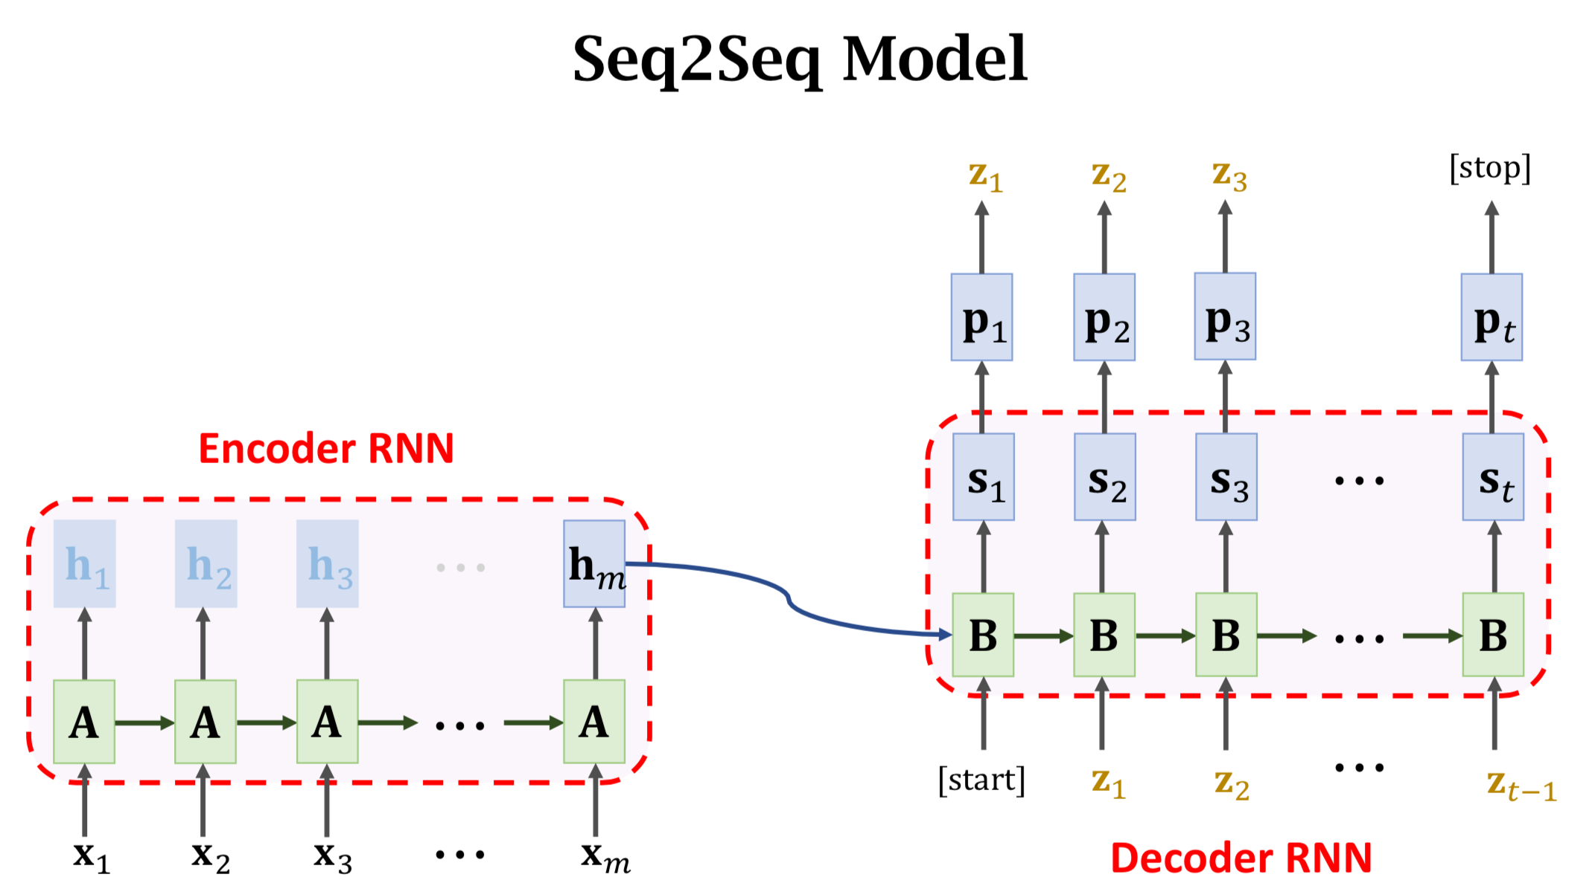

Slide 34
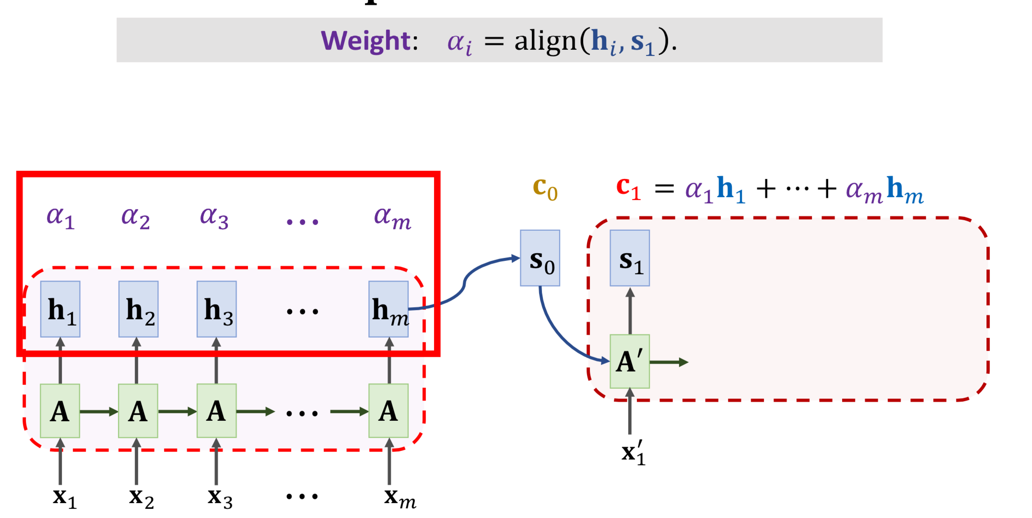
Simple RNN + attention

Slide 35
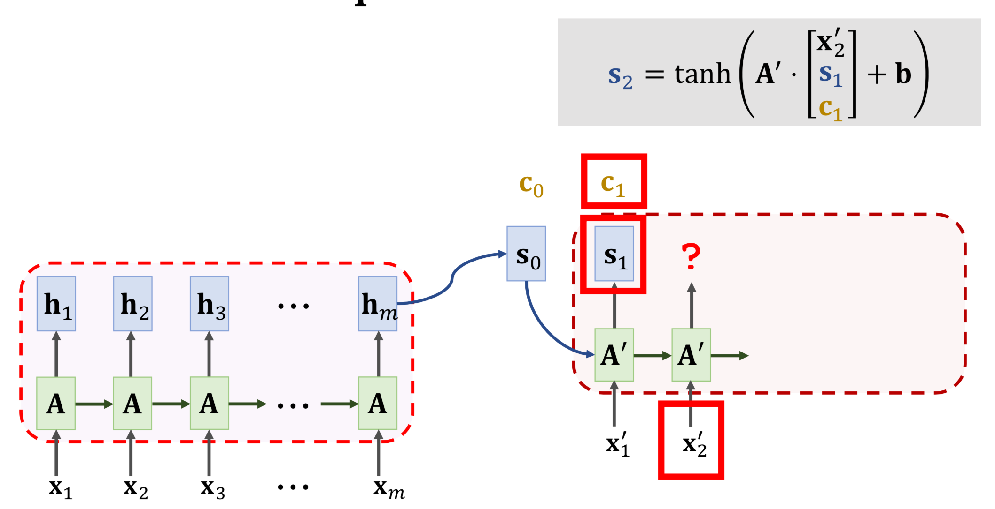
Simple RNN + attention

Slide 36
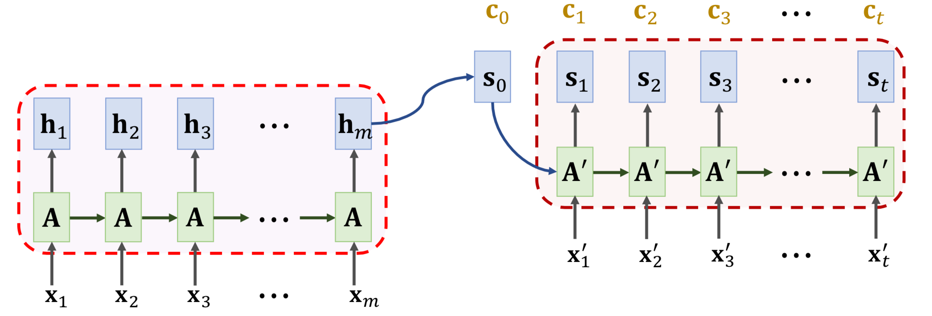
Simple RNN + attention

Slide 37
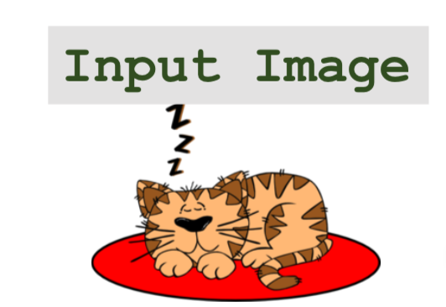
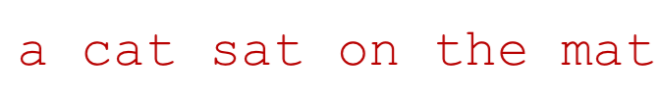
Image caption:
https://machinelearningmastery.com/develop-a-deep-learning-caption-generation-model-in-python/

Slide 38
Outline
CNN and its tricks, papers (Chapter 9)
RNN and LSTM, attention mechanism (Chapter 10)
Neural Networks and ODE/PDE/SDE

Slide 39
Neural Networks and ODE/PDE/SDE
Learning PDE/SDE from data
nonlocal operator as CNN + attention, sample path: RNN based methods, what's the relationship between CNN and RNN?
Non-local Neural Networks

